Slide 1

BUSINESS INSIGHTS 360 : A COMPLETE POWER BI SOLUTION
PRESENTED BY : VINISH KAMBLE

Slide 2
INTRODUCTION
AtliQ Hardware, a fictitious company in the computer hardware industry. AtliQ Hardware operates by supplying products to various customers, including major retailers, distributors, and direct channels, which ultimately cater to the end consumers.
AtliQ Hardware
Brick and Mortar
E-Commerce

Slide 3
OBJECTIVE
Finance View: Analyze financial performance to understand revenue trends, cost structures, profitability, and budget adherence.
Sales View: Examine sales data to identify top-performing products, key sales regions, customer purchasing patterns, and sales growth opportunities.
Marketing View: Customer engagement, and market penetration to optimize marketing strategies and spending.
Supply Chain View: Evaluate and compare errors in sales and forecast and forecast accuracy.
Executive View: Provide a comprehensive overview of key performance indicators (KPIs) and strategic insights to support high-level decision-making and business planning.

Slide 4
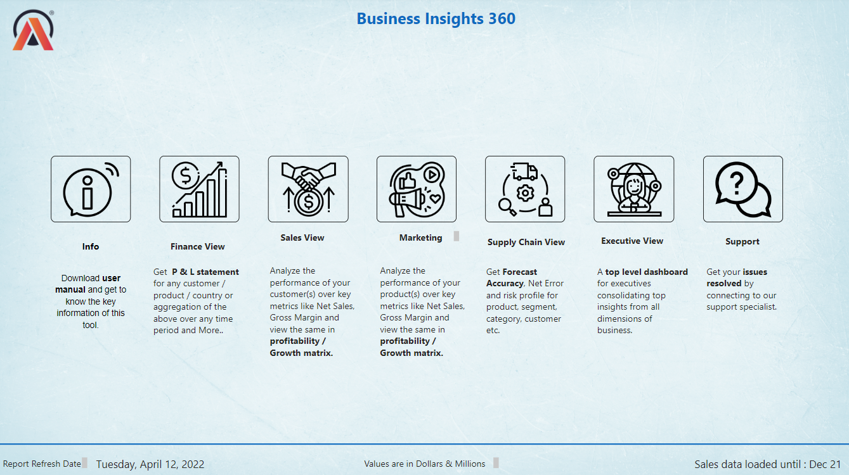
HOME PAGE

Slide 5
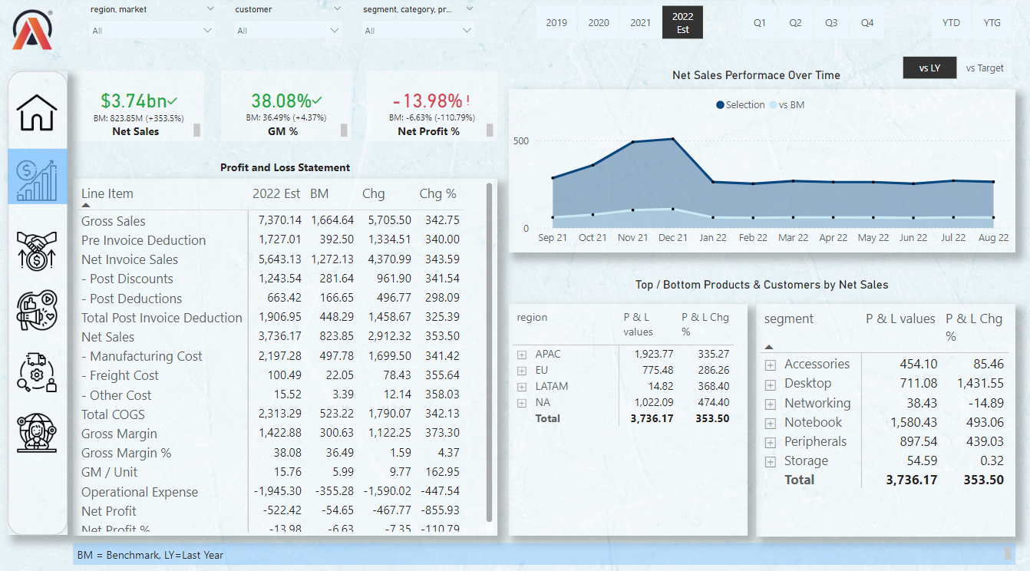
FINANCE VIEW

Slide 6
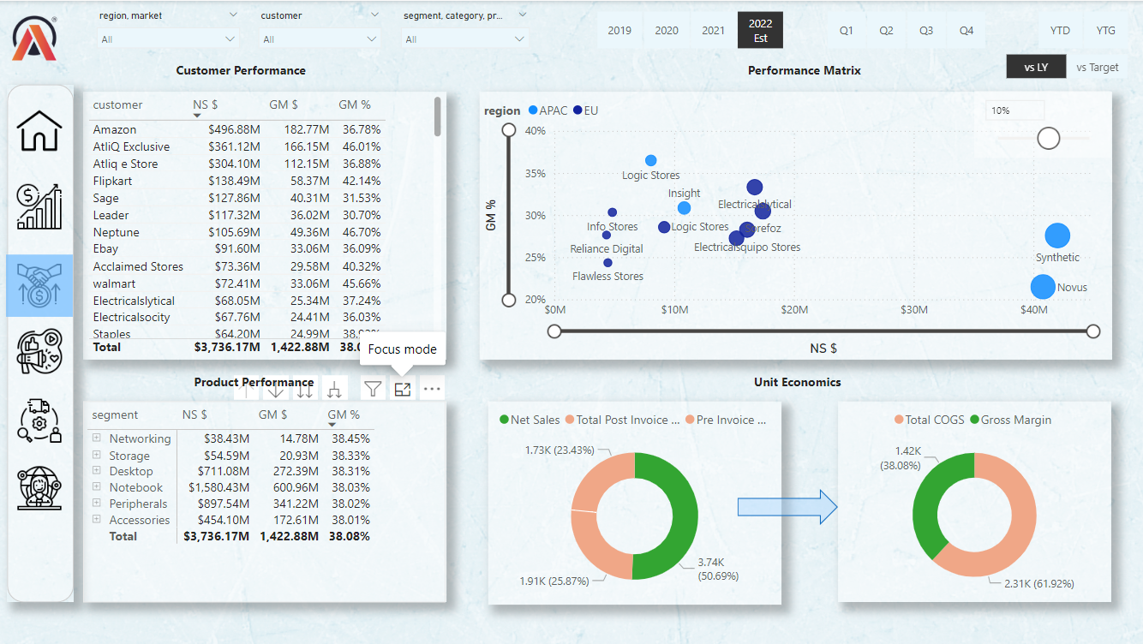
SALES VIEW

Slide 7
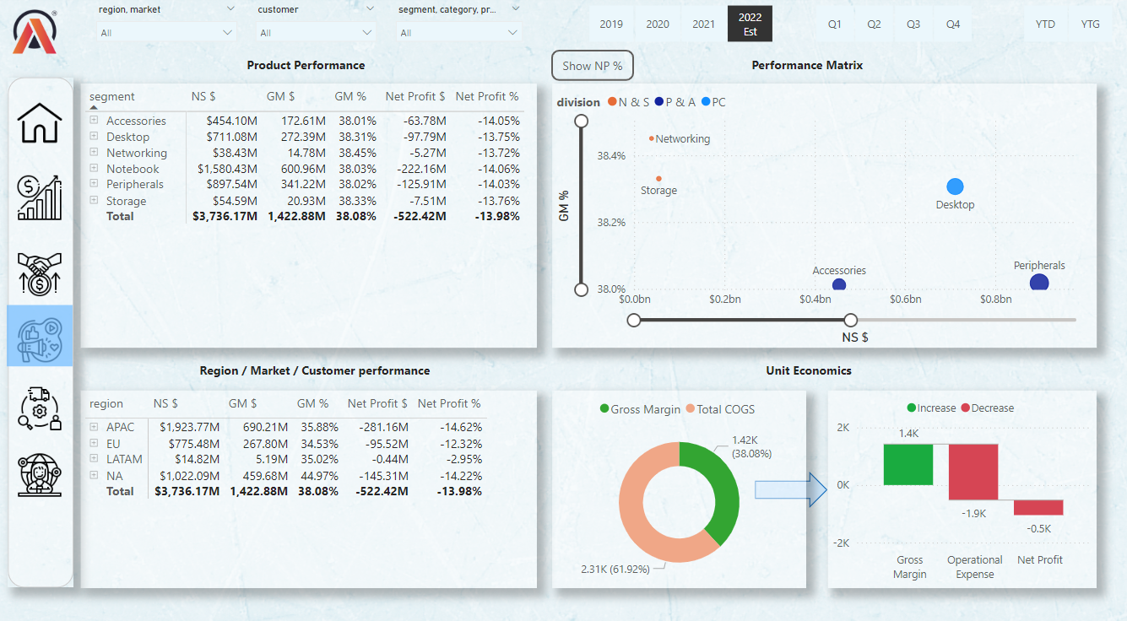
MARKETING VIEW

Slide 8
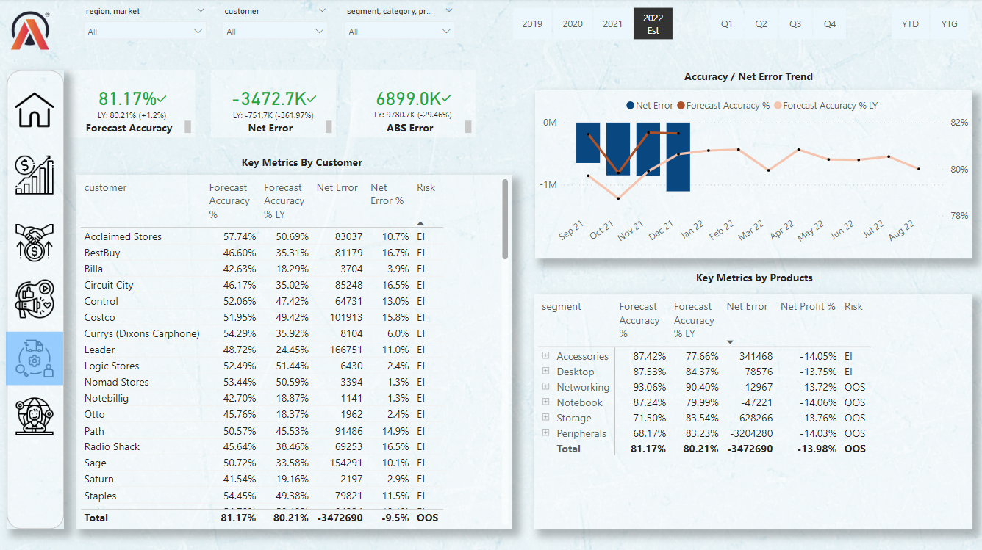
SUPPLY CHAIN VIEW

Slide 9
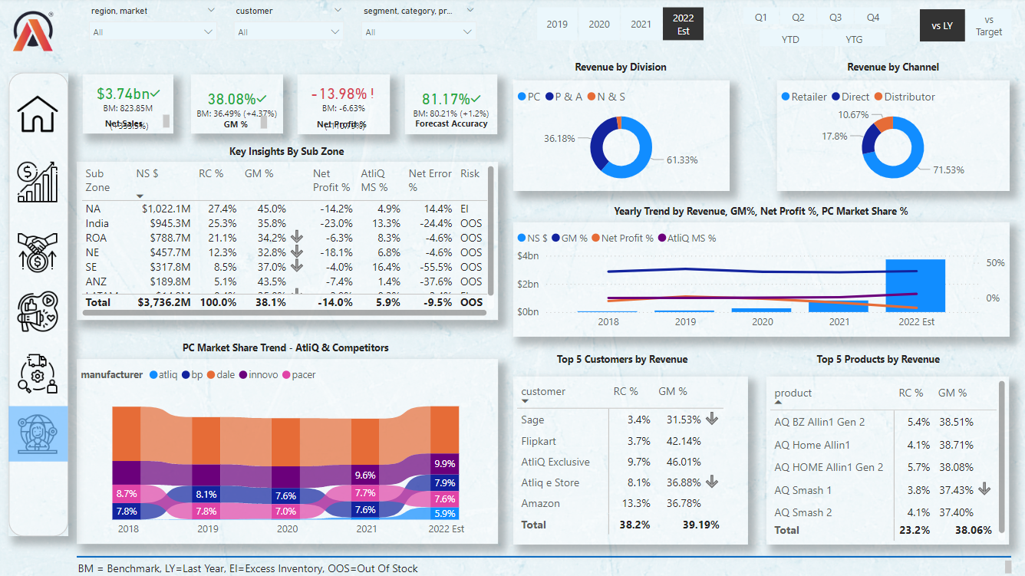
EXECUTIVE VIEW

